Slide 1
Best Coffee Shop Location in Manilla

Slide 2
Introduction of Business Problem:
We assumed that we have a friend who wants to open a coffee shop in the capital city manila of the Philippines. We have to decide where or which neighborhoods have a greater development potential.

Slide 3
Methodology:
Find out a similar city as training dataset.
Using Regression model to predict the number of coffee shop in manilla.
Compare with the existing number of coffee shops
to find out their development potential.
4. Determine the best location of coffee shop.

Slide 4
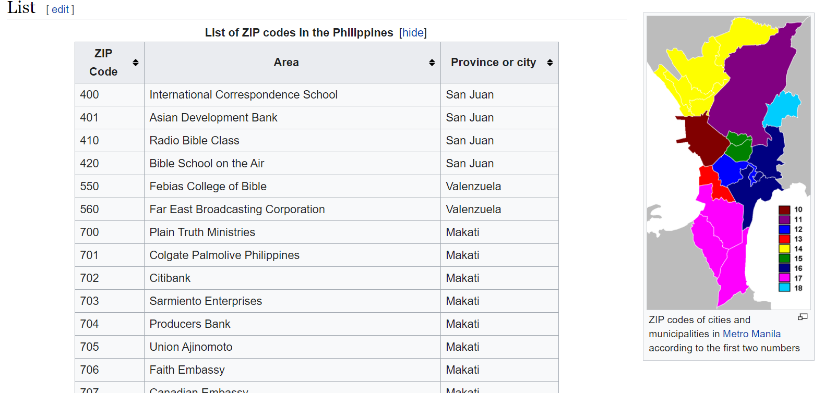
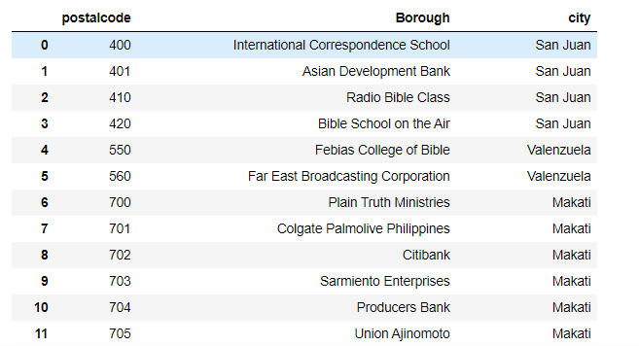
Data acquisition:
Scrap from website and organize into df

Slide 5
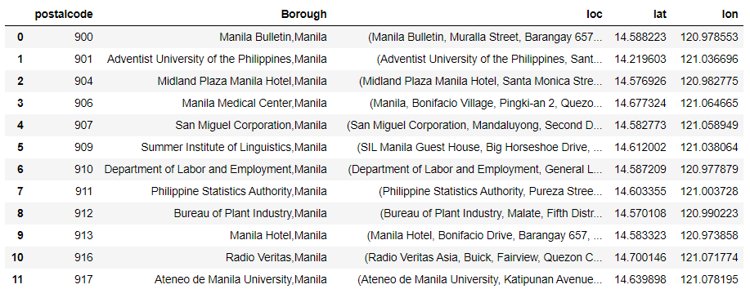
Get location information:
Use geocoder package to get location information

Slide 6
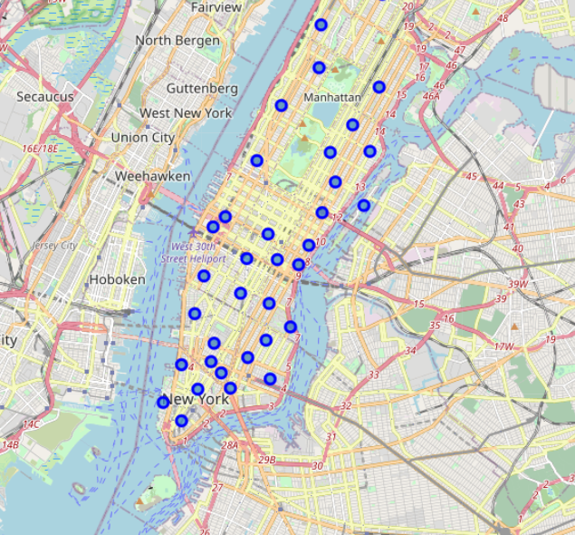
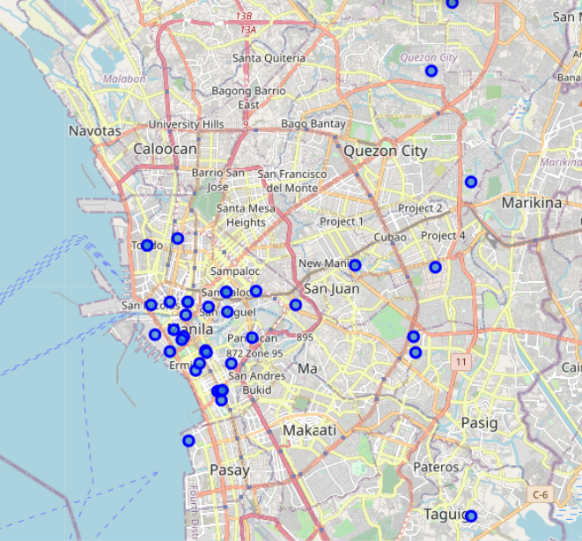
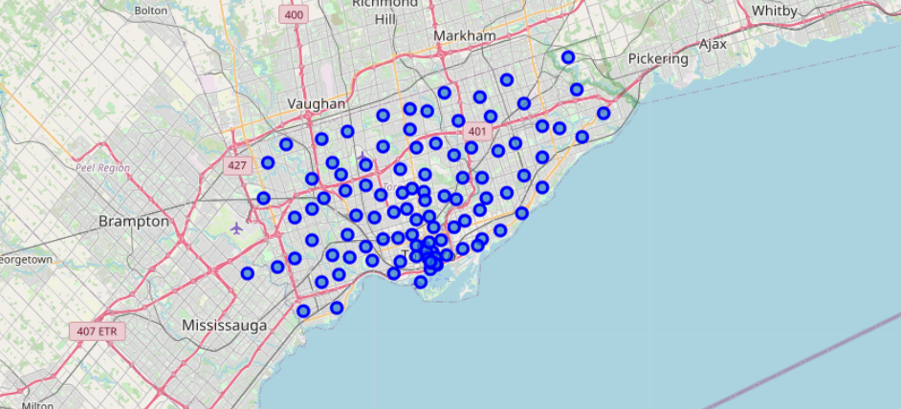
Visualization in maps:
Repeat the steps for cities Toronto and NY cities and visualize them into maps
New York
Manila
Toronto

Slide 7
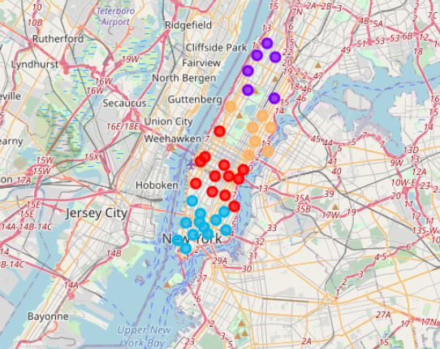
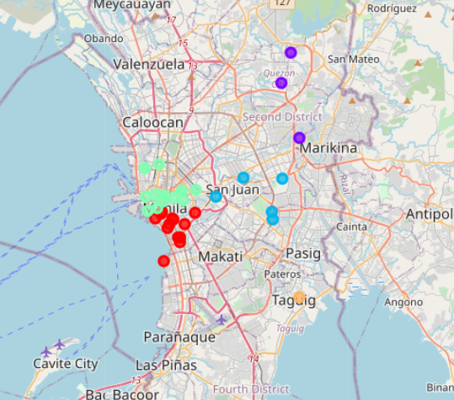
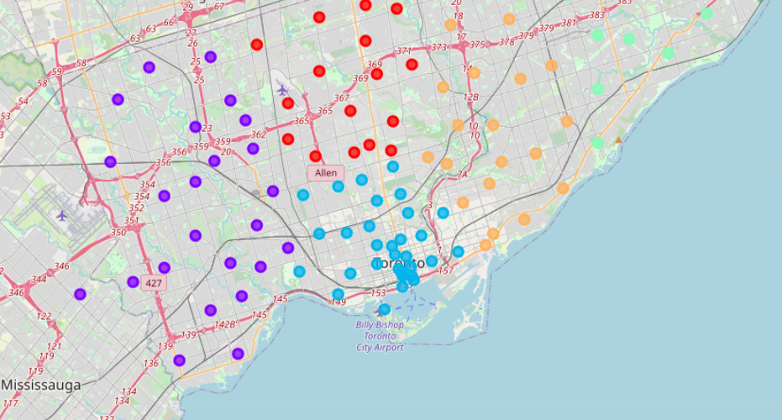
Clustering neighborhoods in maps:
New York
Manila
Manila
Toronto

Slide 8
Conclusion after clustering:
After clustering we can find out that manila was much more similar to Toronto than New York city.
Manila and Toronto have shown a radial distribution of neighborhoods.
The density of neighborhoods increases as the neighborhoods get close to the city centre.
Chose Toronto as training set

Slide 9
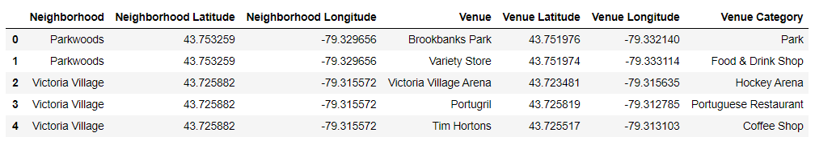
Get venues information:
Use Foursqaure API, we can explore the venues around on specific location, so we could obtain venue‘s name and category
Create one-hot encoding for each category

Slide 10
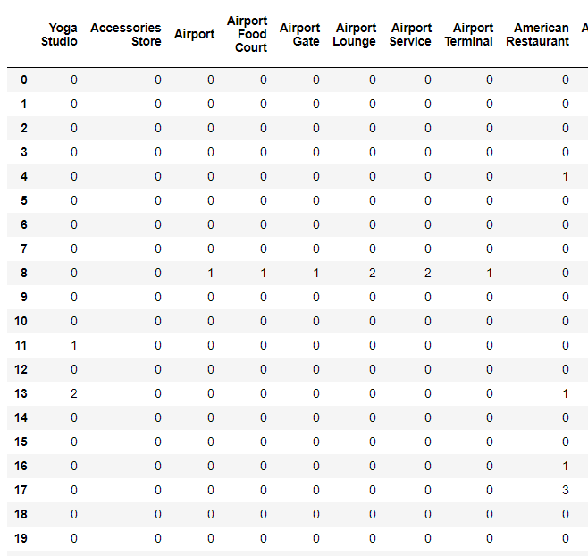
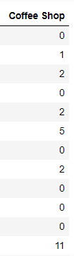
Get X and y data for training:
X_train (dropped Neighborhood and Coffee shop columns)
Y_train
Index:
Neighborhoods

Slide 11
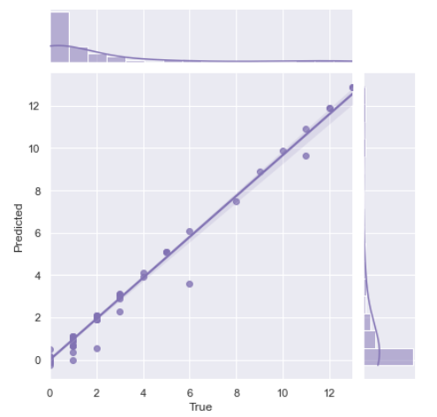
Build Model for prediction:
We use the number of other types of venues in each neighborhood except Coffee Shop as input and the number of Coffee shop as output.
Use SVR(rbf kernel) as learning algorithm
As shown in the figure right hand side, the predicted value matches well to the true value.
We can use this trained model to predict the number of coffee shops in Manila.

Slide 12
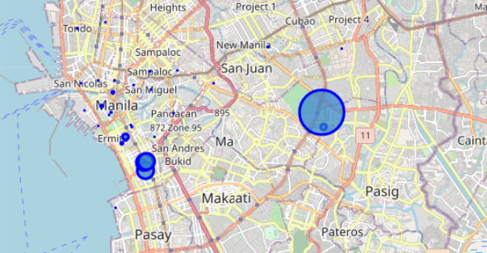
Use Foursquare API to explore the venues around the neighborhoods in Manila.
Repeat steps as same as used in Toronto to build X test data.
Distribution of current coffee shops in each neighborhood, the bigger the radius, the more coffee shops are opened in the neighborhoods.

Slide 13
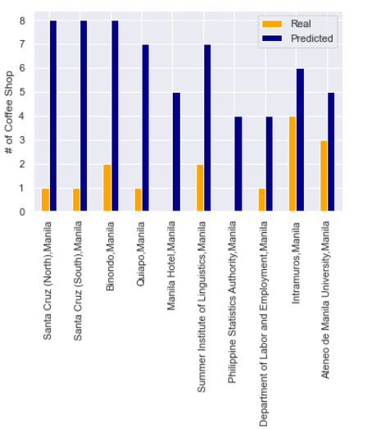
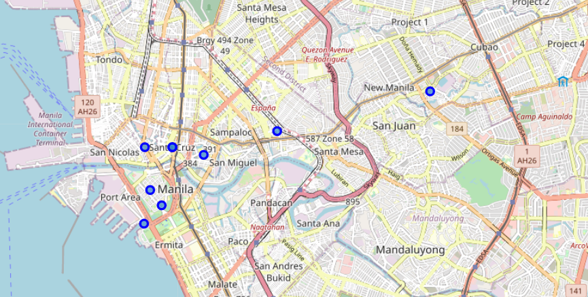
Predict using trained model :
Top 10 recommendations for opening a coffee shop in Manial

